Slide 1

Kotlin
In
Action
Presented by Mehdi Hasanzadeh

Slide 2

Kotlin In Action
Summary Kotlin in Action guides experienced Java developers from the language basics of Kotlin all the way through building applications to run on the JVM and Android devices.
Originally published: December 28, 2016 Authors: Dmitry Jemerov, Svetlana Isakova
Kotlin In Action - M.Hasanzadeh

Slide 3


2. Kotlin Basics
This chapter covers
Declaring functions, variables, classes, enums, and properties
Control structures in Kotlin
Smart casts
Throwing and handling exceptions

Slide 4

Hello World
fun keyword
The parameter type is written after its name
The function can be declared at the top level of a file
Arrays are just classes
Println -> Kotlin standard library
You can omit the semicolon
Kotlin In Action - M.Hasanzadeh

Slide 5
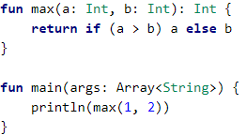
Functions
The function declaration starts with the fun keyword, followed by the function name: max, in this case. It’s followed by the parameter list in parentheses. The return type comes after the parameter list, separated from it by a colon.
Ternary operator in Java: (a > b) ? a : b
Kotlin In Action - M.Hasanzadeh

Slide 6
Statements & Expressions
The difference between a statement and an expression is that an expression has a value
In Java, all control structures are statements. In Kotlin, most control structures, except for the loops (for, do, and do/while) are expressions
assignments are expressions in Java and become statements in Kotlin. This helps avoid confusion between comparisons and assignments, which is a common source of mistakes.
Kotlin In Action - M.Hasanzadeh

Slide 7
Block vs. Expression Body
fun max(a: Int, b: Int): Int = if (a > b) a else b
fun max(a: Int, b: Int) = if (a > b) a else b
for expression-body functions, the compiler can analyze the expression used as the body of the function and use its type as the function return type, even when it’s not spelled out explicitly. This type of analysis is usually called type inference
INTELLIJ IDEA TIP
IntelliJ IDEA provides intention actions to convert between the two styles of functions: “Convert to expression body” and “Convert to block body.”
Kotlin In Action - M.Hasanzadeh

Slide 8
Variables
omits the type declarations
val question = "Is Soroush really a Messenger??"
val answer = 42
If a variable doesn’t have an initializer, you need to specify its type explicitly:
val answer: Int
answer = 42
Kotlin In Action - M.Hasanzadeh

Slide 9
Mutable & Immutable VARIABLES
val (from value)—Immutable reference. final variable in Java
var (from variable)—Mutable reference
you should declare all variables in Kotlin with the val keyword. Change it to var only if necessary. Using immutable references, immutable objects, and functions without side effects makes your code closer to the functional style.
Kotlin In Action - M.Hasanzadeh

Slide 10
M & IM VARIABLES (Cont.)
val reference is itself immutable and can’t be changed, the object that it points to may be mutable.
val languages = arrayListOf("Java")
languages.add("Kotlin")
Error: type mismatch
var answer = 42
answer = "no answer"
Kotlin In Action - M.Hasanzadeh

Slide 11

String Templates
Tip
The compiled code creates a StringBuilder and appends the constant parts and variable values to it
$ : Like many scripting languages
println("\$x")
Nest double quotes within double quotes
Kotlin In Action - M.Hasanzadeh

Slide 12
Classes & Properties
/* Java */
public class Person {
private final String name;
public Person(String name) {
this.name = name;
}
public String getName() {
return name;
}
}
class Person(val name: String)
Kotlin, public is the default visibility
val is read-only, whereas a var property is mutable and can be changed
Kotlin In Action - M.Hasanzadeh

Slide 13

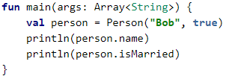
Read-only property: generates
a field and a trivial gette
Writable property: a field, a getter, and a setter
Kotlin In Action - M.Hasanzadeh

Slide 14
Tip
You can also use the Kotlin property syntax for classes defined in Java.
Getters in a Java class can be accessed as val properties from Kotlin, and getter/setter pairs can be accessed as var properties. For example, if a Java class defines methods called getName and setName, you can access it as a property called name. If it defines isMarried and setMarried methods, the name of the corresponding Kotlin property will be isMarried.
Kotlin In Action - M.Hasanzadeh

Slide 15
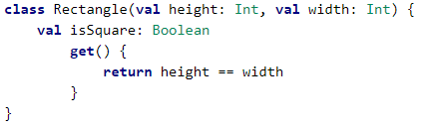
Custom Accessors
get() = height == width
Question?
You might ask whether it’s better to declare a function without parameters or a property with a custom getter
Kotlin In Action - M.Hasanzadeh

Slide 16
Answer
Both options are similar: There is no difference in implementation or performance; they only differ in readability. Generally, if you describe the characteristic (the property) of a class, you should declare it as a property.
Kotlin In Action - M.Hasanzadeh

Slide 17
Directories & Packages
Kotlin doesn’t make a distinction between importing classes and functions, and it allows you to import any kind of declaration using the import keyword. You can import the top-level function by name.
import geometry.shapes.createRandomRectangle
In Kotlin, you can put multiple classes in the same file and choose any name for that file. Kotlin also doesn’t impose any restrictions on the layout of source files on disk;
Kotlin In Action - M.Hasanzadeh

Slide 18
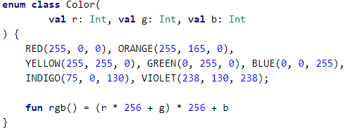
enums and “when
In Kotlin, enum is a so-called soft keyword
Enum constants use the same constructor and property declaration syntax as you saw earlier for regular classes. When you declare each enum constant, you need to provide the property values for that constant
only place in the Kotlin syntax where you’re required to use semicolons
Kotlin In Action - M.Hasanzadeh

Slide 19
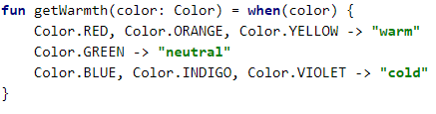
Using “when” to deal with enum classes
Like if, when is an expression that returns a value
a missing break is often a cause for bugs in Java code
Kotlin In Action - M.Hasanzadeh

Slide 20
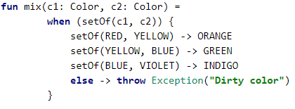
Using “when” with arbitrary objects
Unlike switch, which requires you to use constants (enum constants, strings, or number literals) as branch conditions, when allows any objects.
The Kotlin standard library contains a function setOf that creates a Set containing the objects specified as its arguments
it means either c1 is RED and c2 is YELLOW, or vice versa
Kotlin In Action - M.Hasanzadeh

Slide 21
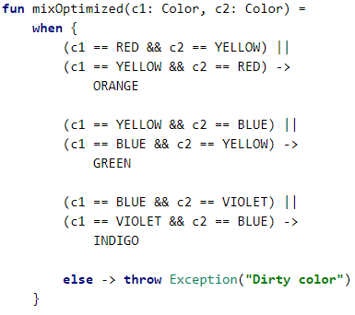
Using “when” without an argument
Normally this isn’t an issue, but if the function is called often, it’s worth rewriting the code in a different way to avoid creating garbage. You can do it by using the when expression without an argument. The code is less readable, but that’s the price you often have to pay to achieve better performance
If no argument is supplied for the when expression, the branch condition is any Boolean expression.
Kotlin In Action - M.Hasanzadeh

Slide 22
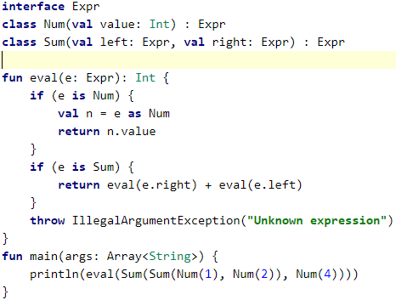
Smart Casts:
combining type checks and casts
First block : This explicit cast to Num is redundant.
Second block : The variable e is smart-cast.
In Kotlin, the compiler does this job for you. If you check the variable for a certain type, you don’t need to cast it afterward; you can use it as having the type you checked for
Kotlin In Action - M.Hasanzadeh

Slide 23

Smart Casts (Cont.)
When you’re using a smart cast with a property of a class, as in this example, the property has to be a val and it can’t have a custom accessor. Otherwise, it would not be possible to verify that every access to the property would return the same value. An explicit cast to the specific type is expressed via the as keyword
INTELLIJ IDEA TIP
The IDE highlights smart casts with a background color.
val n = e as Num
Kotlin In Action - M.Hasanzadeh

Slide 24
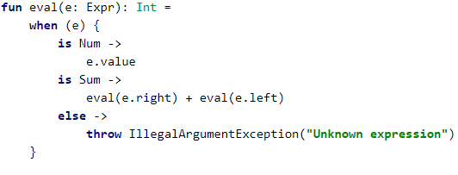
Refactoring:
replacing “if” with “when”
The when expression isn’t restricted to checking values for equality, which is what you saw earlier check the type of the when
Kotlin In Action - M.Hasanzadeh

Slide 25
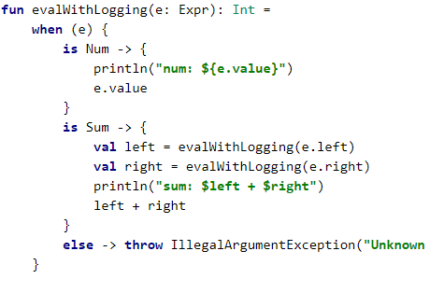
Blocks as branches of “if” and “when”
the last expression in the block is the result
The rule “the last expression in a block is the result” holds in all cases where a block can be used and a result is expected
this rule doesn’t hold for regular functions
Kotlin In Action - M.Hasanzadeh

Slide 26
Iterating over things:
“while” and “for” loops
for <item> in <elements>
Kotlin has while and do-while loops, and their syntax doesn’t differ from the corresponding loops in Java
Kotlin In Action - M.Hasanzadeh

Slide 27
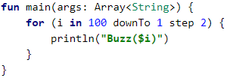
Iterating over numbers:
ranges and progressions
val oneToTen = 1..10
.. operator
Note that ranges in Kotlin are closed or inclusive
The most basic thing you can do with integer ranges is loop over all the values. If you can iterate over all the values in a range, such a range is called a progression
The step can also be negative
Unltil syntax:
for (x in 0 until size) ~~ for (x in 0..size-1)
Kotlin In Action - M.Hasanzadeh

Slide 28
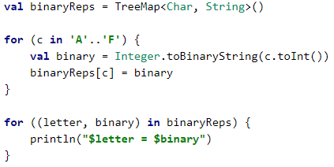
Iterating over maps
Iterates over a map, assigning the map key and value to two variables
The rule “the last expression in a block is the result” holds in all cases where a block can be used and a result is expected
this rule doesn’t hold for regular functions
Kotlin In Action - M.Hasanzadeh

Slide 29
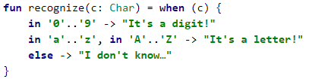
Using “in” to check collection and range membership
Iterates over a map, assigning the map key and value to two variables
You use the in operator to check whether a value is in a range, or its opposite, !in, to check whether a value isn’t in a range
The in and !in operators also work in when expressions.
If you have any class that supports comparing instances (by implementing the java.lang.Comparable interface), you can create ranges of objects of that type
Kotlin In Action - M.Hasanzadeh

Slide 30
Exceptions in Kotlin
in Kotlin the throw construct is an expression and can be used as a part of other expressions
variable isn’t initialized
val percentage =
if (number in 0..100)
Number
Else
throw IllegalArgumentException(
"A percentage value must be between 0 and 100: $number")
Kotlin In Action - M.Hasanzadeh

Slide 31
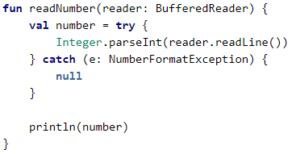
“try”, “catch”, and “finally”
The biggest difference from Java is that the throws clause isn’t present in the code: if
you wrote this function in Java, you’d explicitly write throws IOException after the
function declaration
What about Java 7’s
Try-with-resources?
Kotlin doesn’t have any
special syntax for this;
Kotlin In Action - M.Hasanzadeh

Slide 32
THE
END

